Slide 1


UW ENGINE - SPRING 2024
NASA - Jet Propulsion Laboratory Data Science for Scientific Discovery
Chris (Jui-Wei) Chang
Amy (Shiyun) Zhou
Doria (Jiaqi) Dong
Sean Jung
Long Thanh Nguyen
Mazzy Chen
Tung Thanh Dang
University of Washington
Electrical & Computer Engineering
06 May 2024

Slide 2
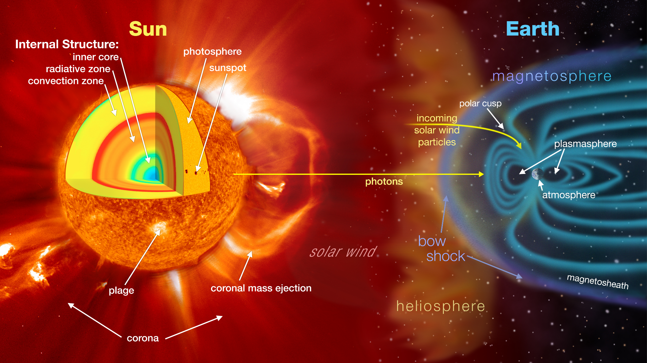
Coronal Mass Ejection (CME) Phenomenon
Source: NASA Scientific Visualization Studio

Slide 3
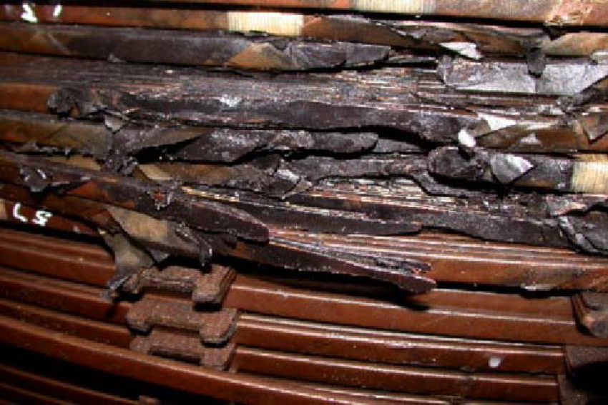
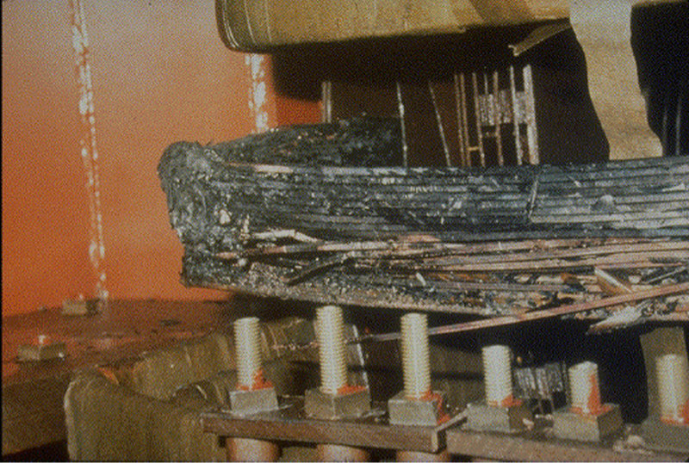
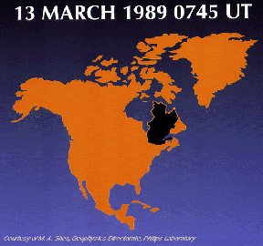
What are Geomagnetic Induced Currents (GIC)?
Transformer Damage & Blackout
October 28-29, 2003
Near South Africa
Transformer Damage & Blackout
March 13, 1989
Quebec, Canada
Notes:
GICs can create great damage into our critical electrical infrastructure, causing power outages that can last for hours and millions of dollars in damage.

Slide 4
Primary Objectives
Create a framework for studying risk and resiliency of a space weather natural hazard on a certain critical infrastructure.
Integrate data from various domains to provide deeper insight on how solar events impact critical infrastructure.
Utilize machine learning models to predict outcomes in various space weather cases and identify subtle underlying connections.
Provide risk and resilience analysis for the critical infrastructure such power grid and communications systems through the provided datasets.
Explore the characteristics of space weather impacts on global critical infrastructure; primarily, electrical power grids and communications systems.

Slide 5



UW ENGINE Team and Research Areas
Team Breakdown
Extreme Value Analysis
Chris (Jui-Wei) Chang
Amy (Shiyun) Zhou
Network Analysis
Sean Jung
Doria (Jiaqi) Dong
Machine Learning
Long Thanh Nguyen
Mazzy Chen
Tung Thanh Dang
Primary Datasets:
SuperMAG (1970-present)
Super Magnetospheric Automated Geophysical Observatory (SuperMAG)
Provides global magnetic field observations from multiple international entities, organized by John Hopkins Applied Physics Laboratory.
OMNIWeb NASA (1963-present)
Observations and Measurements of the Interplanetary Medium (OMNI)
Provides interplanetary magnetic field (IMF) data, solar energetic particle (SEP) data, geomagnetic indices, and other field data from spacecraft in geocentric orbit detecting solar winds
NERC GIC (2013-present)
North American Electricity Reliability Corporation (NERC) Geomagnetic Disturbance Incidents (GMD)
Provides geomagnetically induced currents (GICs) on U.S electrical power grid.

Slide 6
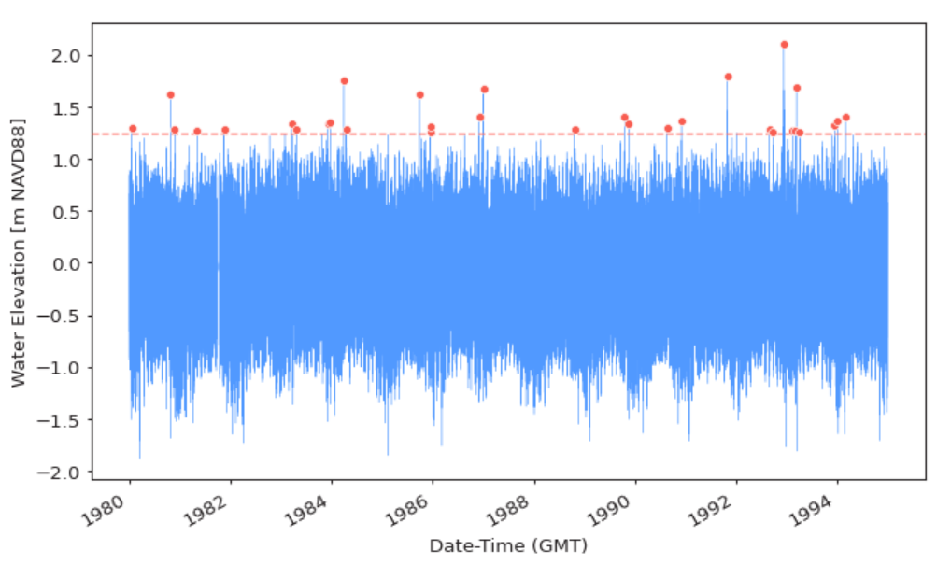
Extreme Value Analysis
Objective:
To analyze extreme values of solar events for forecasting future events.
Approach:
Extract the extreme values of GIC in every station from every events and create a probability distribution curve.
Feed analysis to the machine learning models for forecasting.
In the Next Slides:
Displayed the GIC extreme values by specific solar event, displayed using a colored heatmap.
White dots = locations of Database of power grid anomalies ( 1940 A.D.~1980 A.D.)

Slide 7
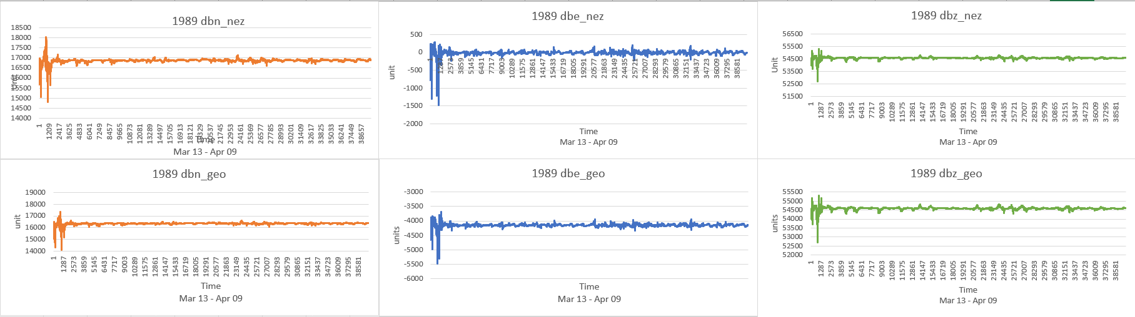
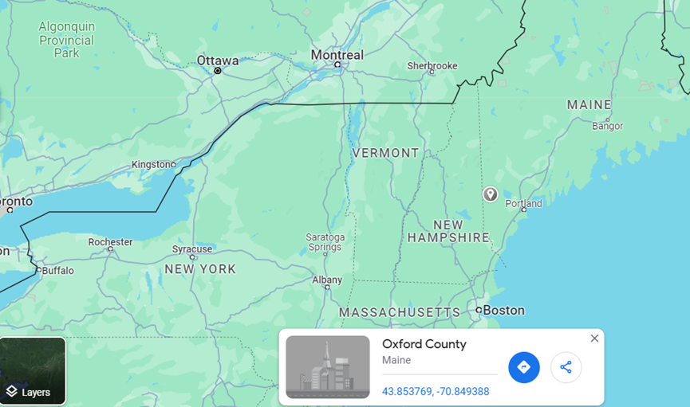
Relation between variation of magnetic field and anomalies powergrid events
Identify relations between dB/dt and power-grid anomalies in same location and timeline
Notes:
After peaking into the data, there are dozens of powergrid hazard happened around “Mar 13” at the similar location “latitude41~43 : longtitude -70~-73”. In the SuperMAG data of 1989 A.D, the nearest station is “Ottawa station”
Found out the dB/dt is indeed variate during the time period where hazard occurred. Both magnetic field variation in a local coordinate system (nez) and in a geographic coordinate system(geo) have similar reaction. Thinking it is possible to take these parameter into our model.
(The hazard occurred Mar 13 1989, the data of this chart starts from Mar 13, 00:00:00 to Apr 09, 23:59:00 )

Slide 8
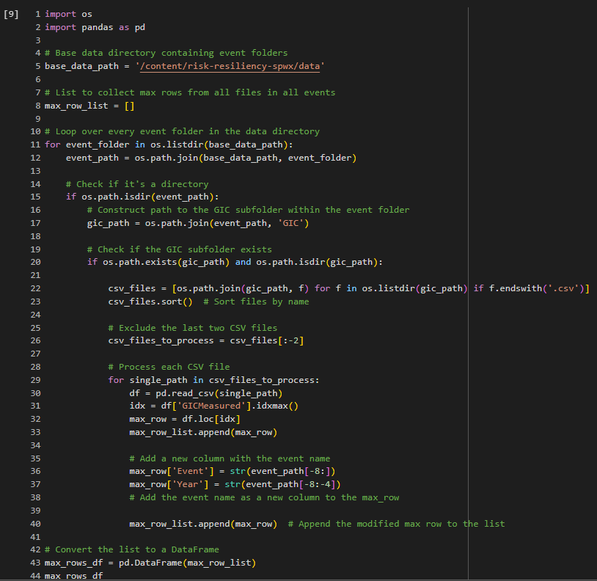
Processing raw data of
NERC GIC value
Using python to process the NERC GIC data.
Parameters from Dataset.
Coordinates (for each devices ID)
Timelines
GICmeasure max_values
Event names
Event time (By year)
Visualization:
Combining “NERC GIC data” and “Database of power grid anomalies” on map

Slide 9
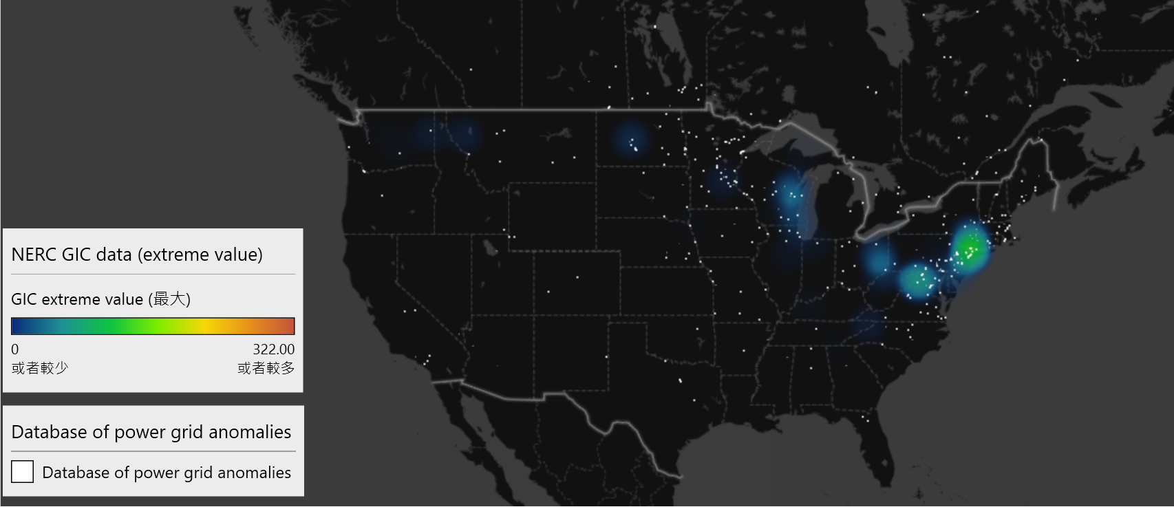
2013 May 31
amp
amp

Slide 10
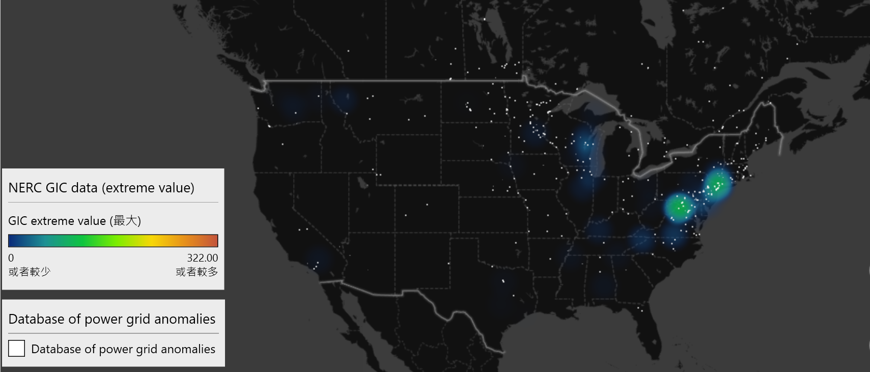
2013 October 02
amp
amp

Slide 11
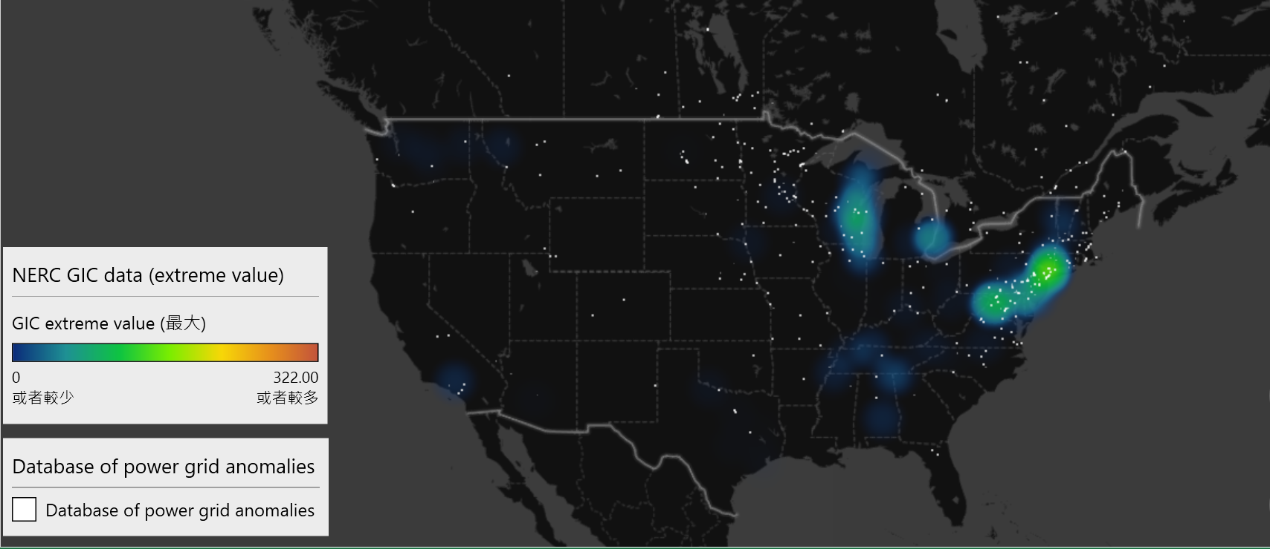
2015 March 17
amp
amp

Slide 12
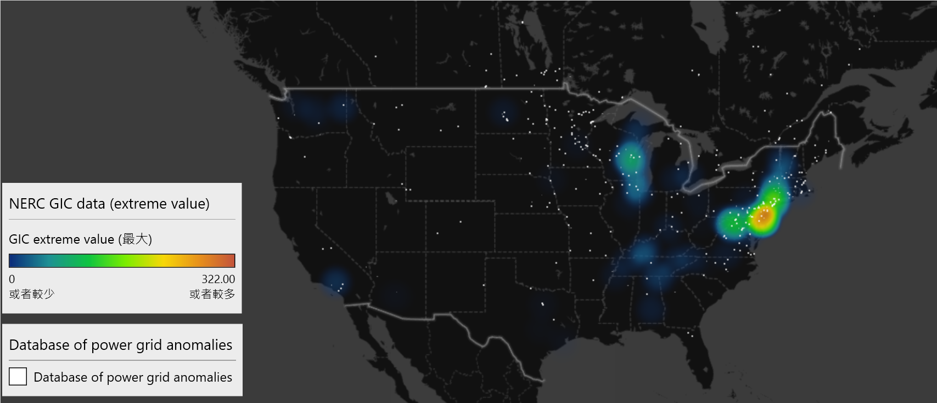
2015 June 22
amp
amp

Slide 13
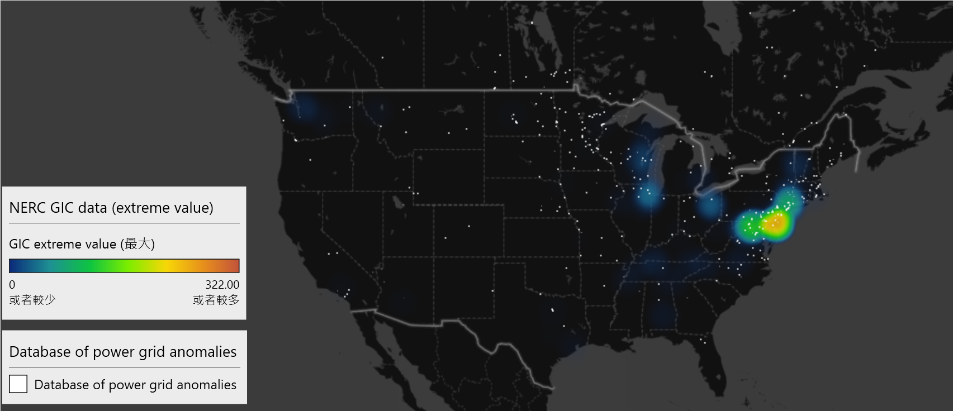
2015 September 11
amp
amp

Slide 14
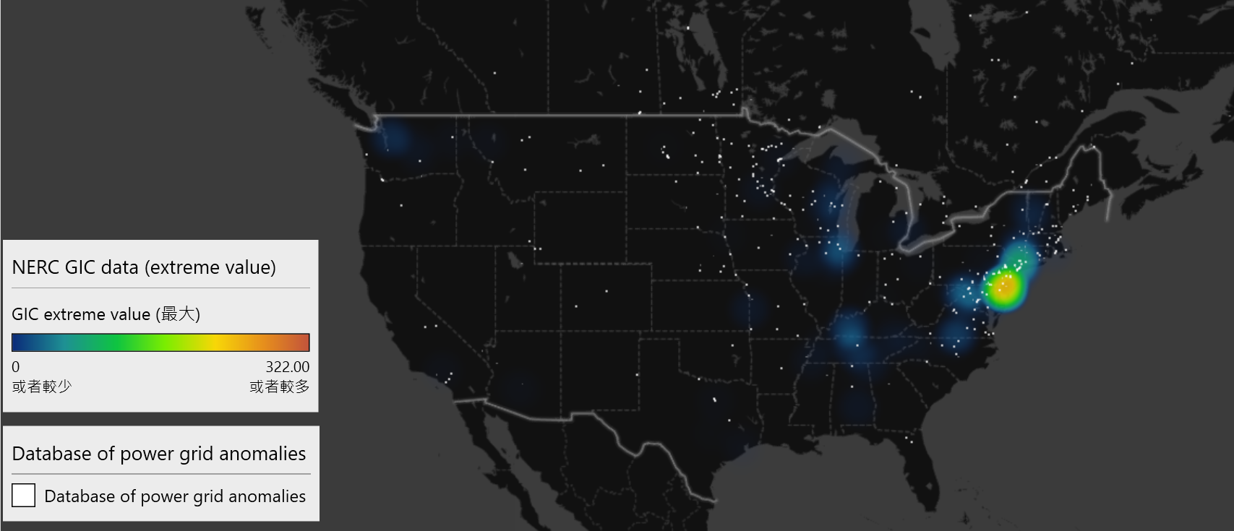
2015 September 19
amp
amp

Slide 15
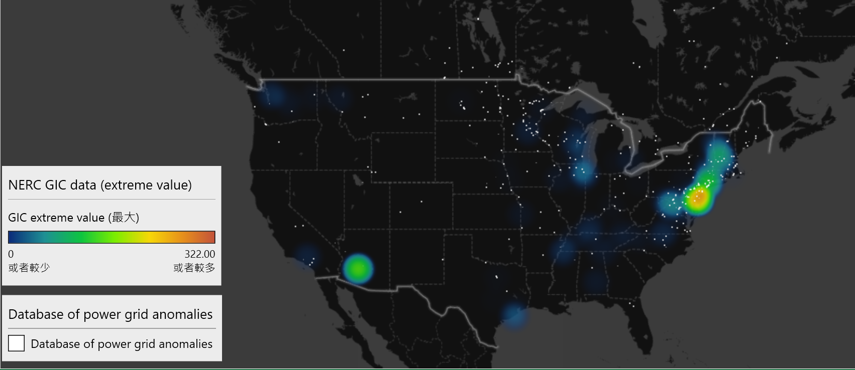
2015 October 06
amp
amp

Slide 16
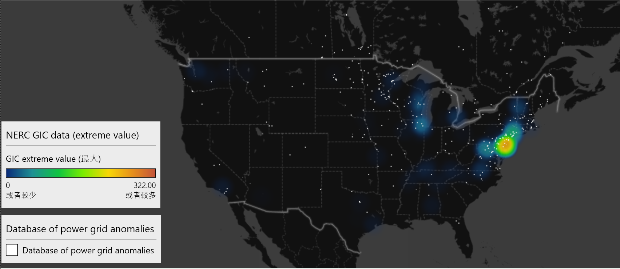
2015 December 20
amp
amp

Slide 17
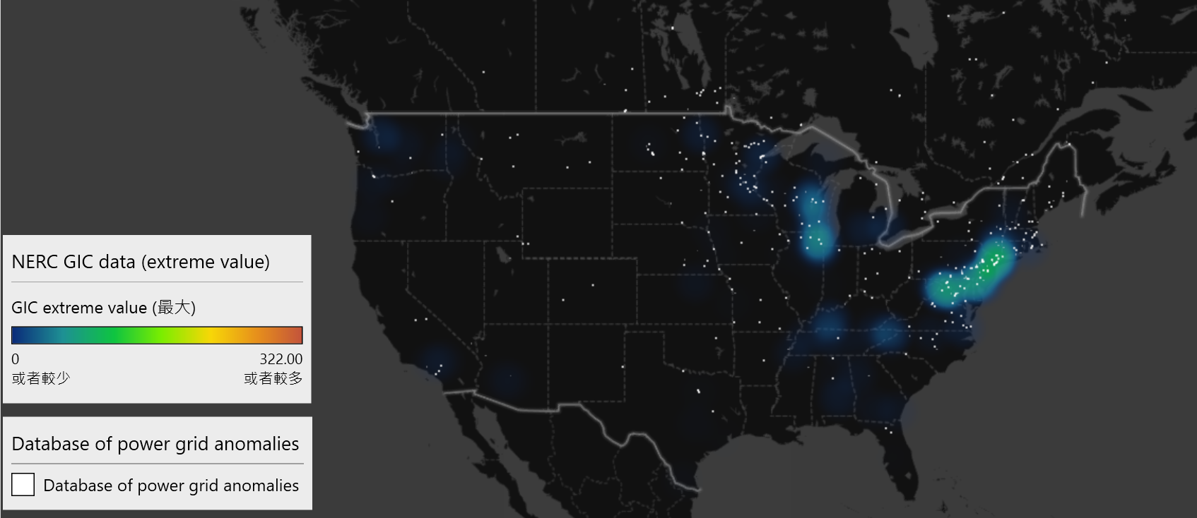
2017 May 27
amp
amp

Slide 18
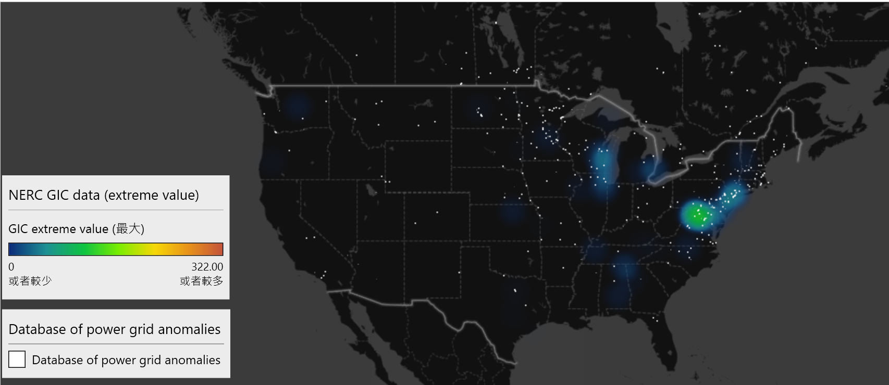
2017 September 07
amp
amp
amp
amp

Slide 19
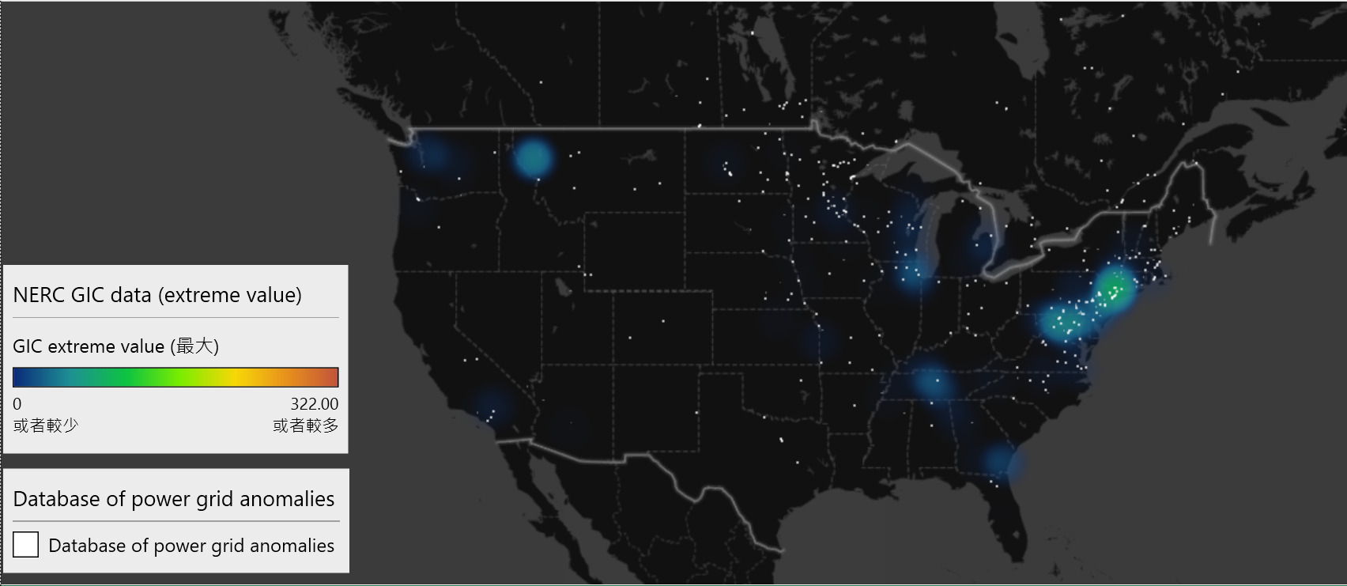
2017 September 27
amp
amp

Slide 20
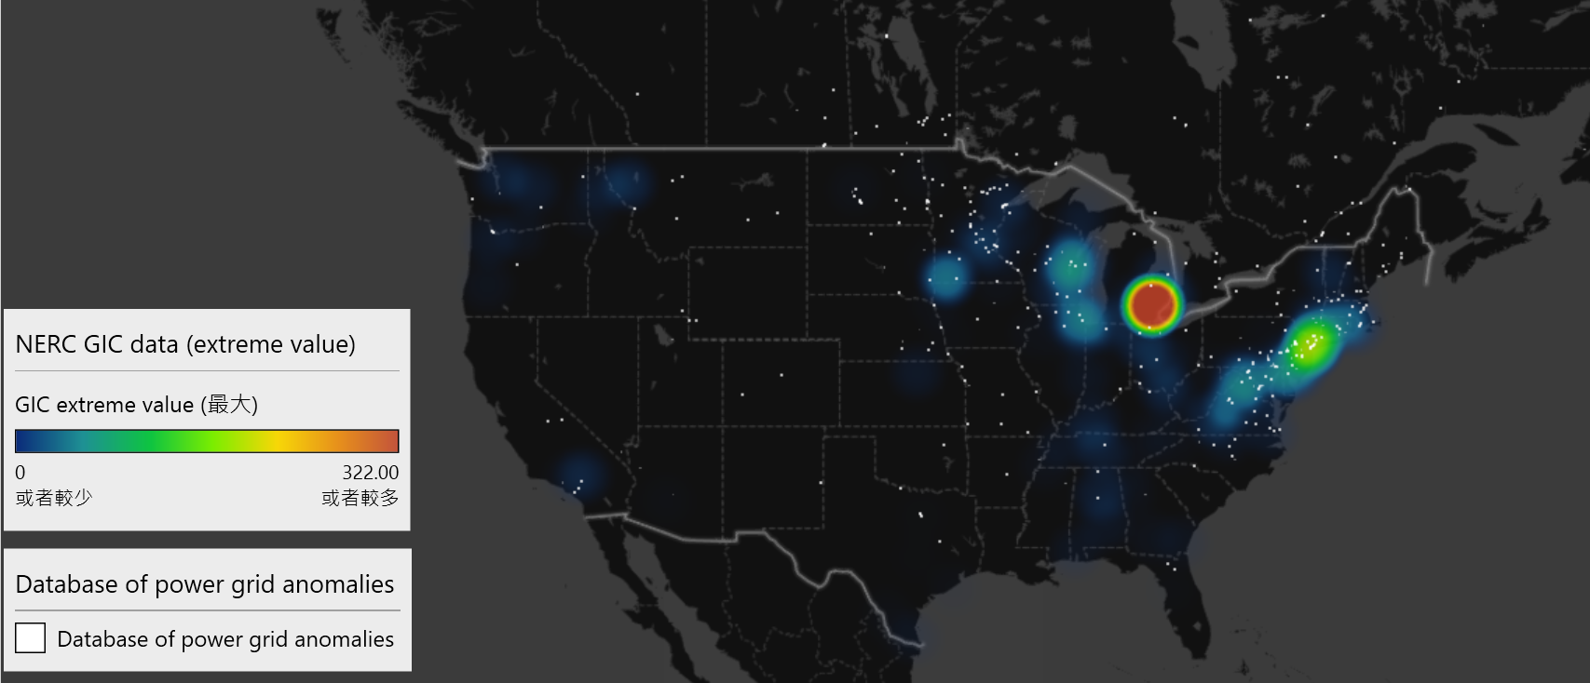
2018 August 25
amp
amp

Slide 21
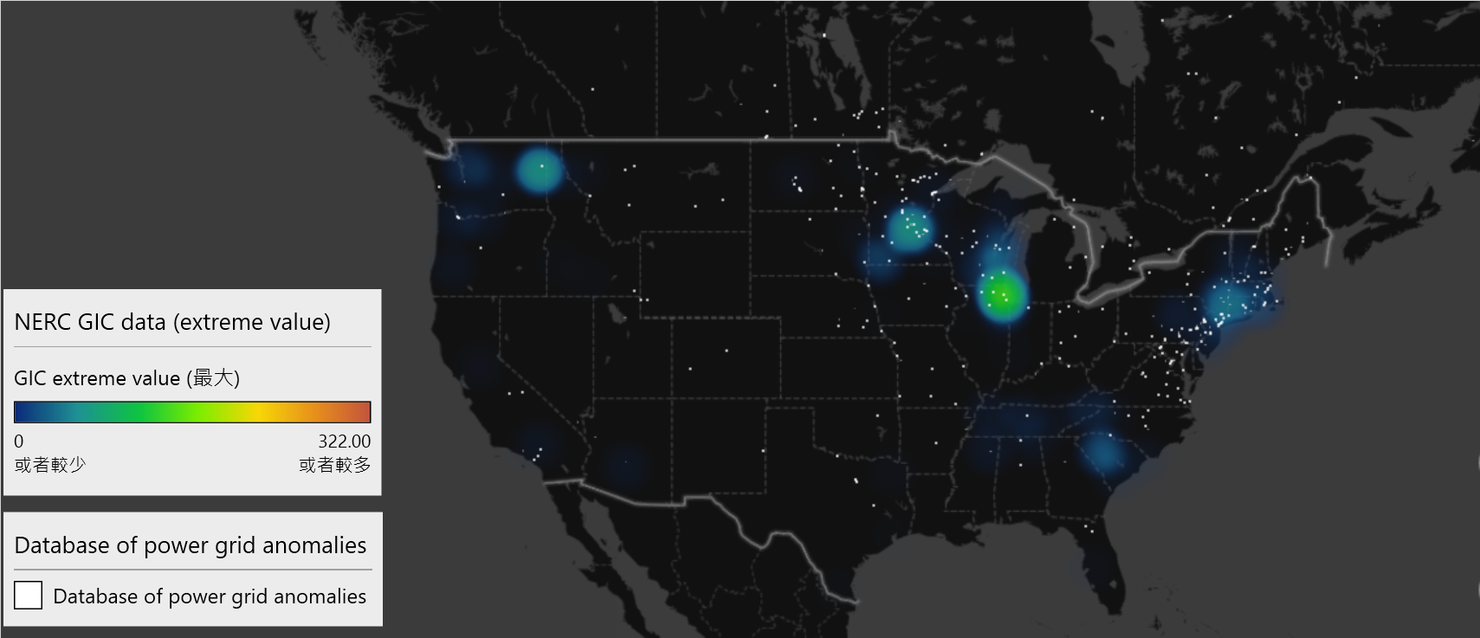
2021 May 12
amp
amp

Slide 22
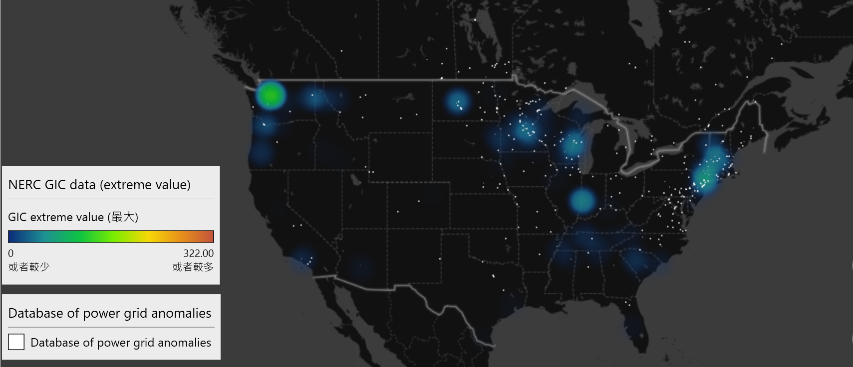
2021 November 03
amp
amp
amp
amp

Slide 23
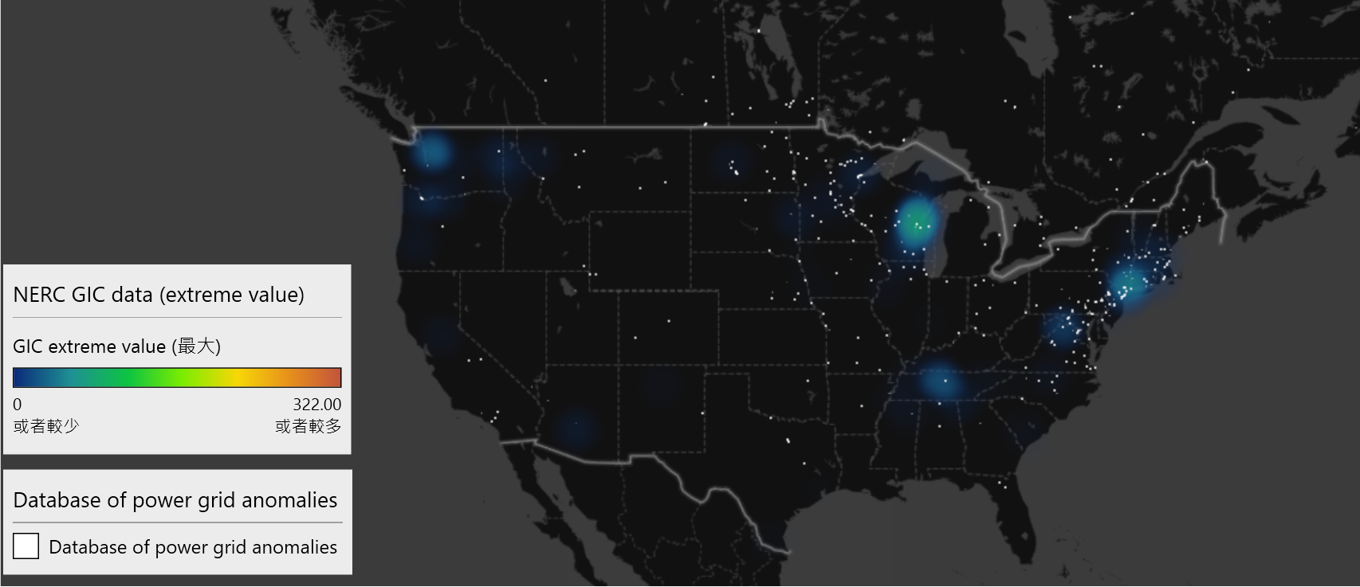
2022 April 09
amp
amp

Slide 24
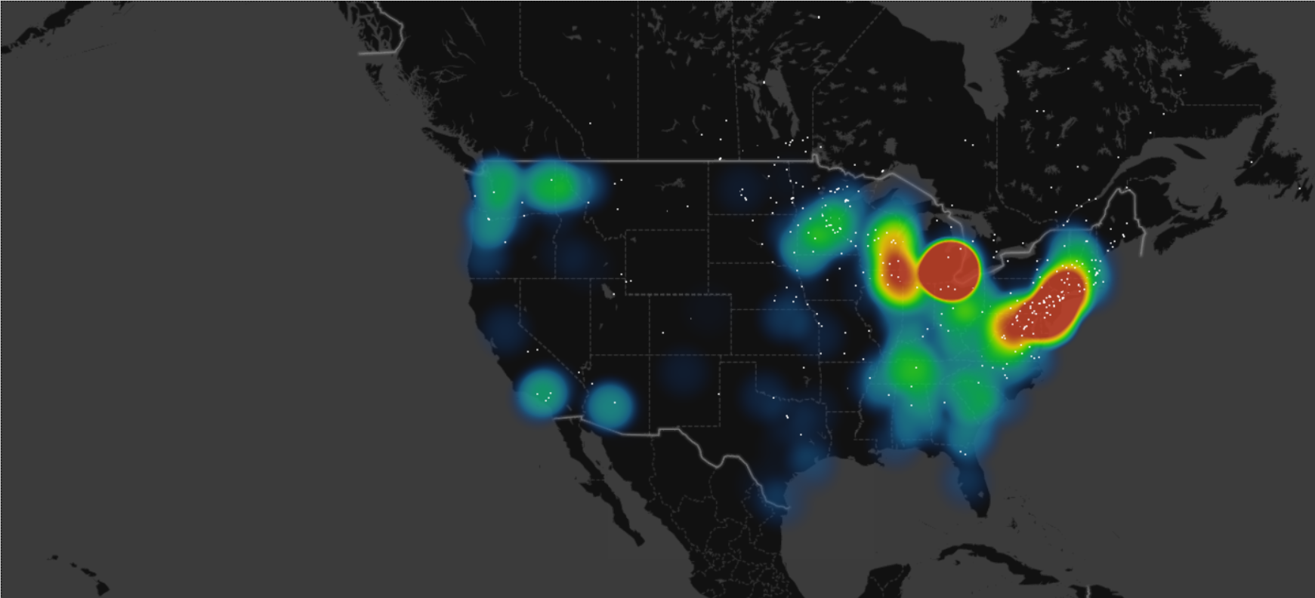
Average GIC extreme values from every events (2013 ~ 2022)
The density of extreme GIC values is concentrated around the East Coast, particularly near Washington, D.C., and in the Michigan area.
Factors:
Power-grid & elec trans line infrastructure
Geology (e.g. Appalachian mountain)
Earth surface impedance
Notes:
We integrate the data for ML team for them to take the timeline and coordinates into ML feature

Slide 25
Average GIC extreme values from every events (2013 ~ 2022)
Notes:
We integrate the data for ML team for them to take the timeline and coordinates into ML feature

Slide 26
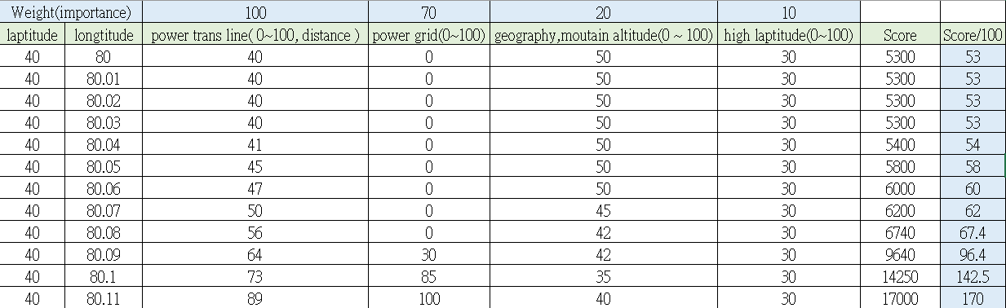
Extreme value analysis – quantifying the risk
Create a spreadsheet cover all coordinates of USA, and specify the features that may affect the GIC, multiply the number with their own weights and get the final score.
Issue: It require more background knowledge to validate the features. Scale of weight is uncertain.
Example:

Slide 27
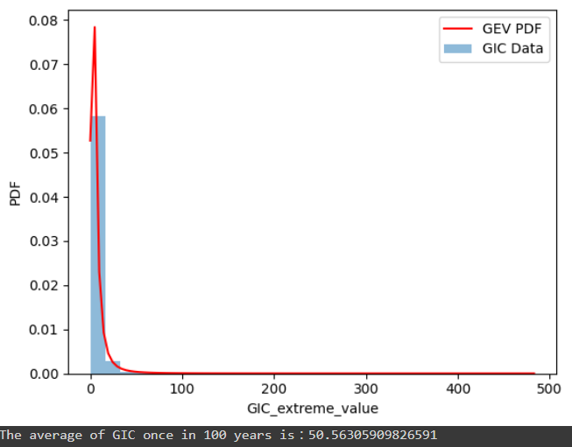
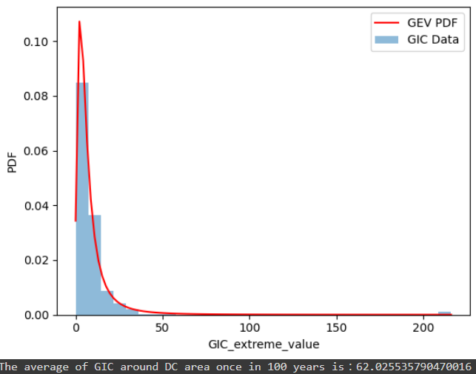
GEV for 100 years estimation ( General and near DC area)
from scipy.stats import genextreme
c, loc, scale = genextreme.fit(filtered_gic_values) # DC area
GEV for GIC in North America
GEV for GIC around DC area

Slide 28
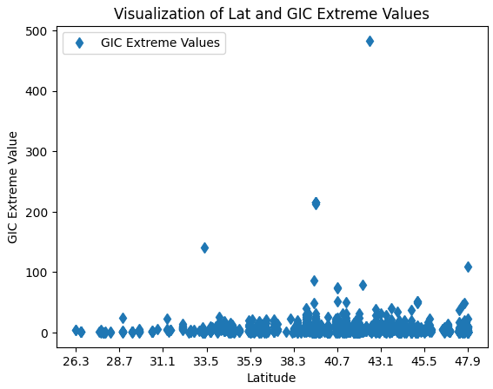
Direct visualization of GIC and Latitude

Slide 29
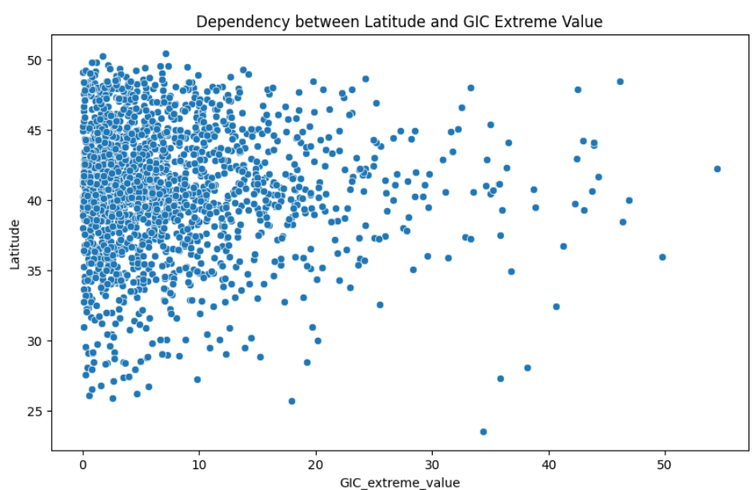
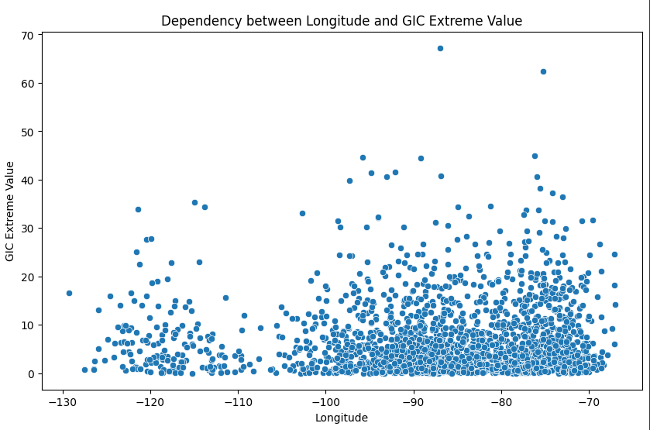
Tail Dependence Analysis (Correlation between GIC with Lat & Long)
from copulas.multivariate import GaussianMultivariate
X_axis: GIC
Y_axis: Latitude
X_axis: Longitude
Y_axis: GIC

Slide 30
Extreme Value Analysis
Things have been looked up:
GEV (Generalized Extreme Value for 100 years estimation)
Tail Dependence Analysis ( Dependency of space and gic_extreme_values)
To be studied:
GPD (Generalized Pareto Distribution)
POT (Peak Over Threshold)

Slide 31
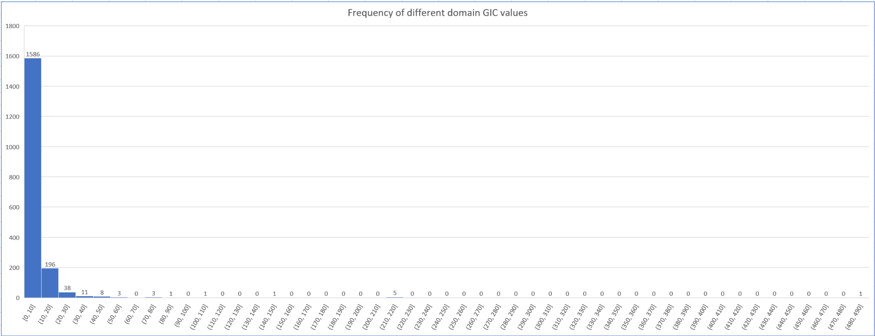
Frequency of domains GIC extreme values
Most GIC_extreme_values lie between [0,10], [10,20]

Slide 32
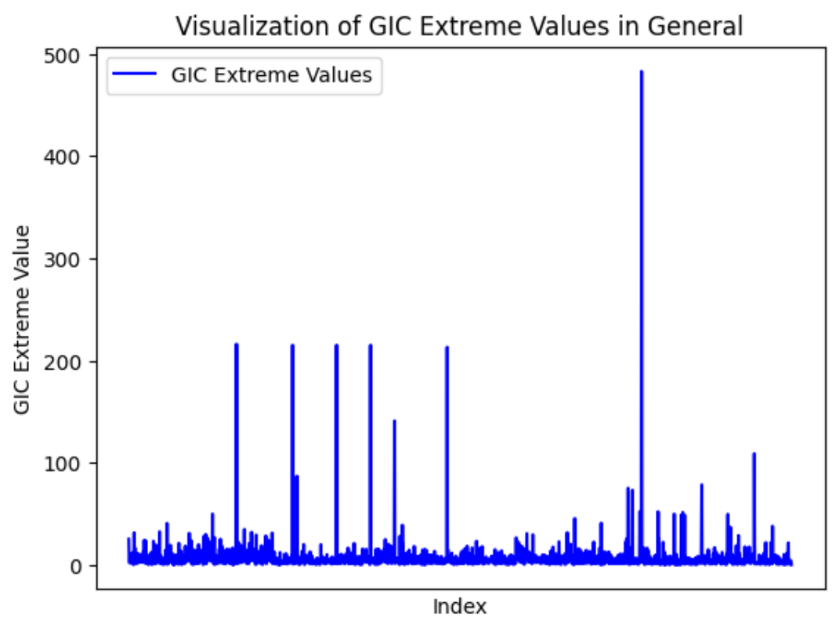
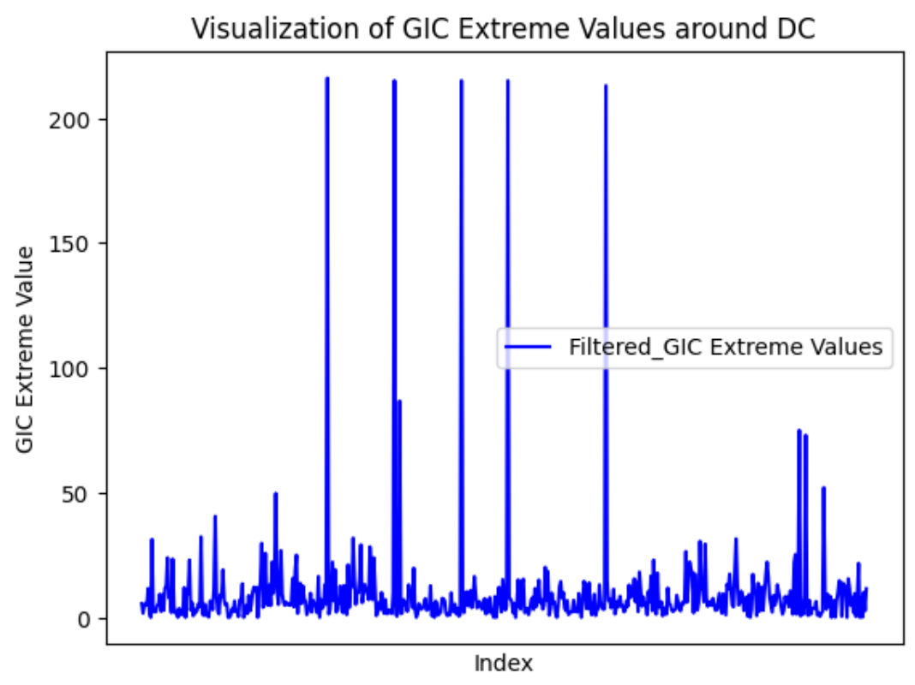
Visualizing GIC extreme values
Near Michigan
Choosing locations around DC:
Latitude: 37.23~ 42.32 ; Longitude: -79.11 ~ -72.54

Slide 33
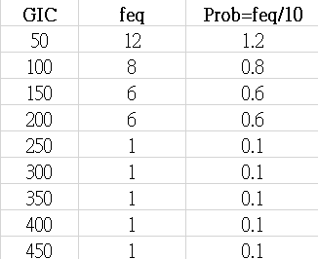
Extreme value analysis
Using probability to estimate the extreme GIC once in 100 years
(Feq means how many events that exceed the GIC thres within 10 years)
50

Slide 34
1-100 years GIC extreme value estimation
Concept:
Step1. Extract GIC value that over 50 amp
Step2. Calculate the frequency( frequency means that number of events that exceed the threshold value)
Step3. Divide the feq with 10(years) and get a probability
Step4. Goal is to estimate the GIC when prob = 0.01(once in 100 years)

Slide 35
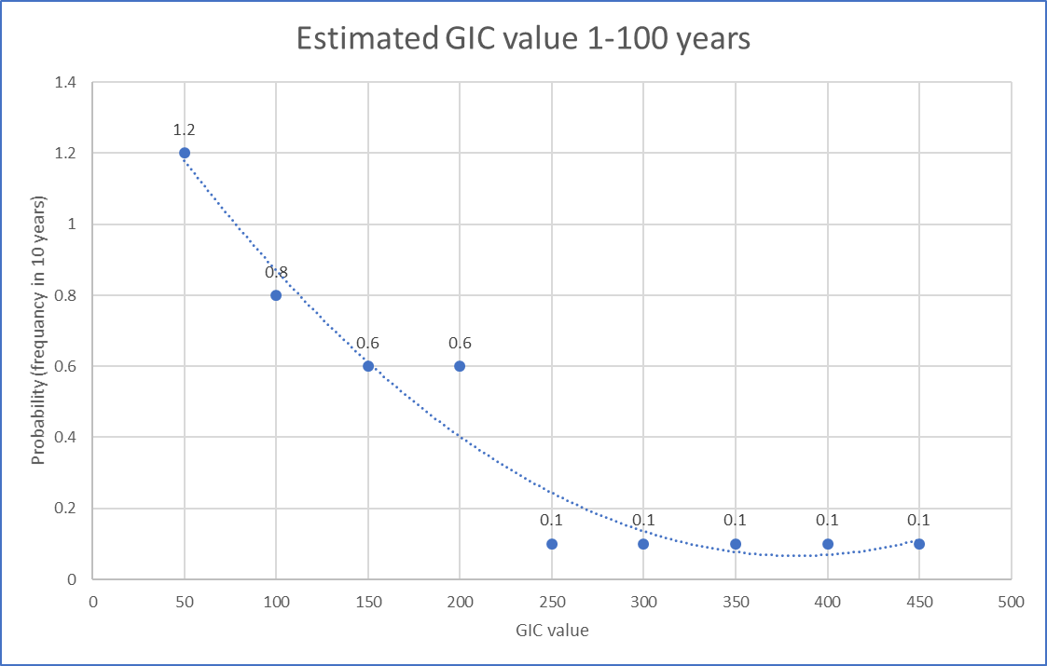
Model with original data points
Issue:
The 2-order polynomial equation will not be accurate for higher GIC

Slide 36
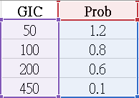
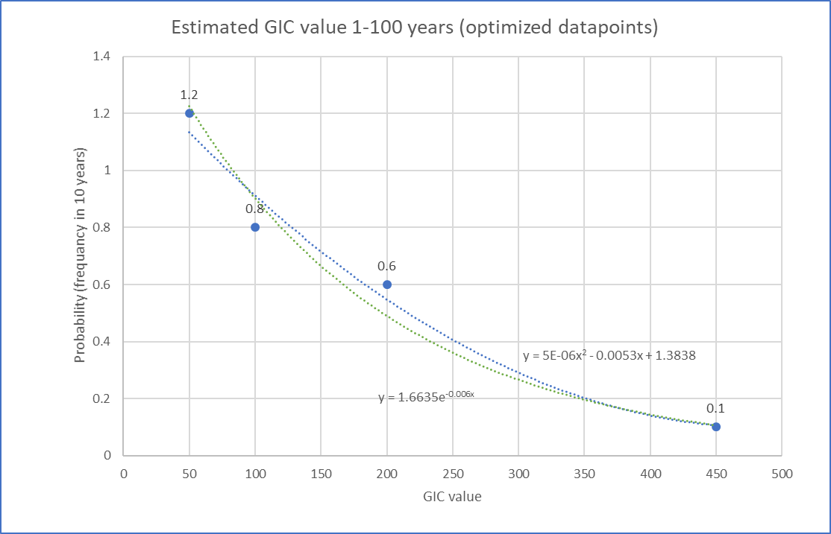
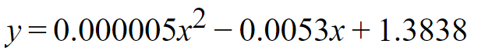
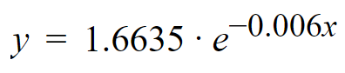
Excluding redundant data points to optimize regression function
Blue line: 2-order polynomial equation
When y = 0.01, x = 608.35 v 451.64
Green line: Natural exponential function
When y = 0.01, x = 852.348 (worse case)

Slide 37
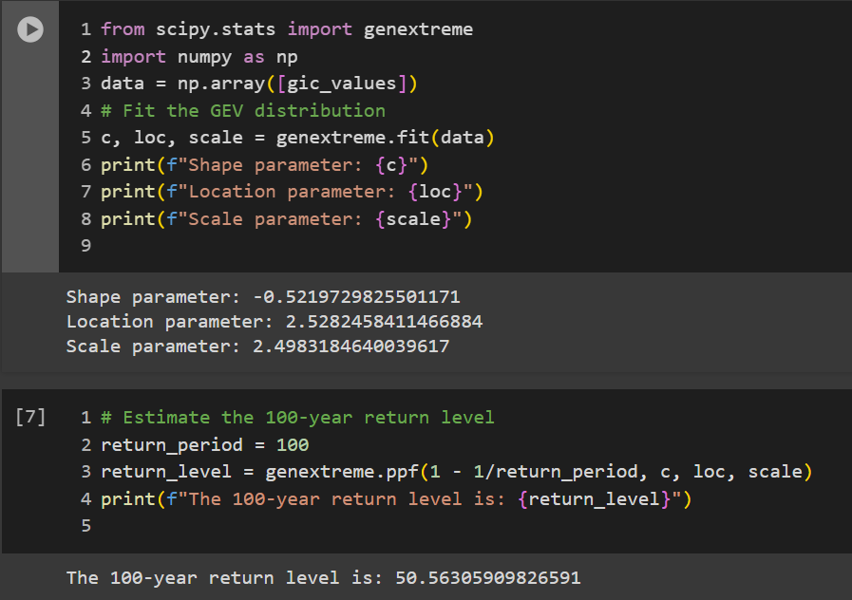
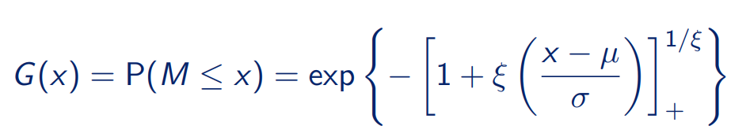
Steps I’m going to do next
Set our data into ‘block’, select one extreme value from each sensor for each event
This step has been done last quarter
Fitting the data into GEV distribution.
I used a package called genextreme from scipy, but the result turned out to be inaccurate
I think the problem is resulted from the x (timeline), since currently the data timeline is overlapping within different stations, maybe extract the maximum gic_value from same time ?

Slide 38
Steps I’m going to do next
Set our data into ‘block’, select one extreme value from each sensor for each event
This step has been done last quarter
Fitting the data into GEV distribution.
I used a package called genextreme from scipy, but the result turned out to be inaccurate
I’ll try harder on the EVA method from your provided slides, but is there any opinion ?
In the second half of the EVA slide, it mentions about correlation between different parameters and building grids on map
I will embark on them asap once I finish the GEV part

Slide 39
Data constraints in GEV
Extreme values should extract from fixed periods (ex. From each year or each month)
Independency: Every data is independent from any others
Sufficient data: the more data, the more precise the estimation result
Time range should be long enough ( When there are at least 20-30 years of observations)
Abnormal data or Outlier: those data may compromise the model
Time gap between each data should be identical (one data from one year)
Definition of ‘extreme value’ should be clear and specific ( When interested in obtaining estimates for extreme quantities that lie outside the range of the observed data. The variable of interest should be stochastic )

Slide 40
The GEV model and concept
Return Level zT: This is the return value of event that happens once in every T years. And we want T to be 100, which is 1-100 years estimation)
Threshold exceedances:
Threshold too high => not enough data, high uncertainty . Threshold too low => non extreme data modelled, model not suitable

Slide 41
Issues with our data and models
Time gap problem: Our dataset is not separated by fixed time gap
Time range of our dataset is does not meet the 20 years requirement
Occurred years of each event:
2013 x 2
2015 x 6
2017 x 3
2018 x 1
2021 x 2
2022 x 1
2023 x 3
Top 8 EV happened in :
2015 x 6
2018 x 1
2021 x 1
Summary: we are lack of data from ‘2014’, ‘2016’, ‘2019’, ‘2020’
Violate the rule: Time period between data is not fixed

Slide 42
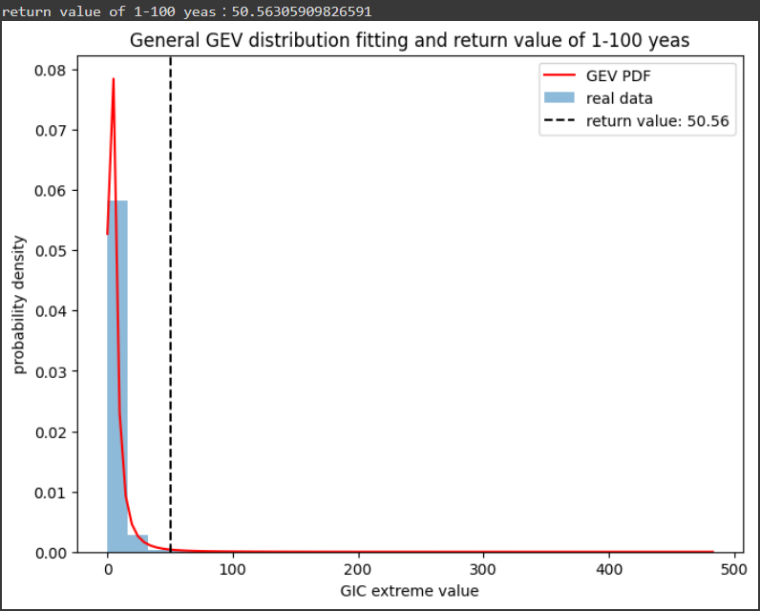
All GIC extreme values in GEV model (Using our previously processed GIC data)
Return value of 1-100 years = 50.56 amp (Too low)
Issues:
The data contains too many low values, we should set a threshold value (99% of data is under 50 amp)

Slide 43
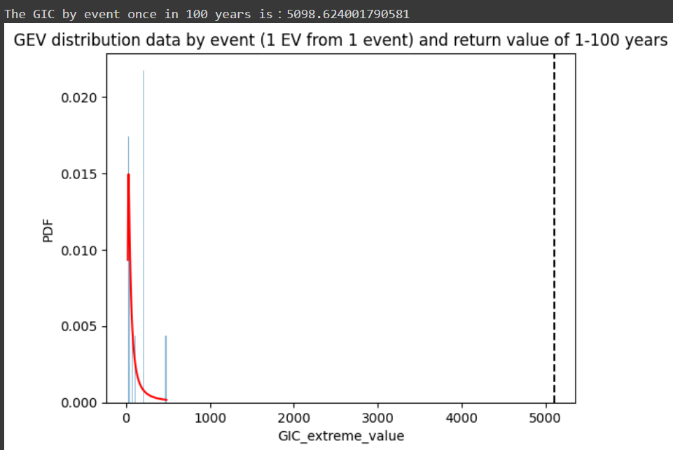
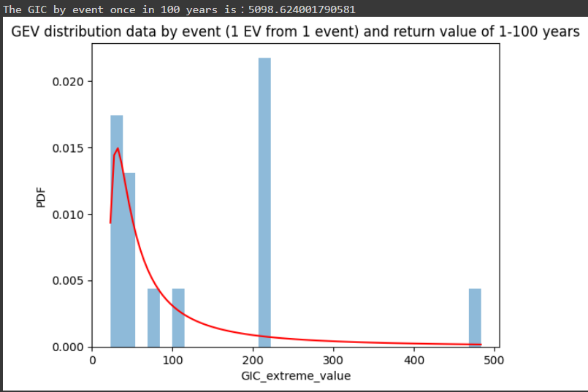
GIC extreme values ‘by events’ into GEV model (Extract the maximum value from each event)
Return value of 1-100 years = 5098.62 amp (Too high)
Issues:
After we extracting maximum values from each events, the number of data is too small ( only 15 data).

Slide 44
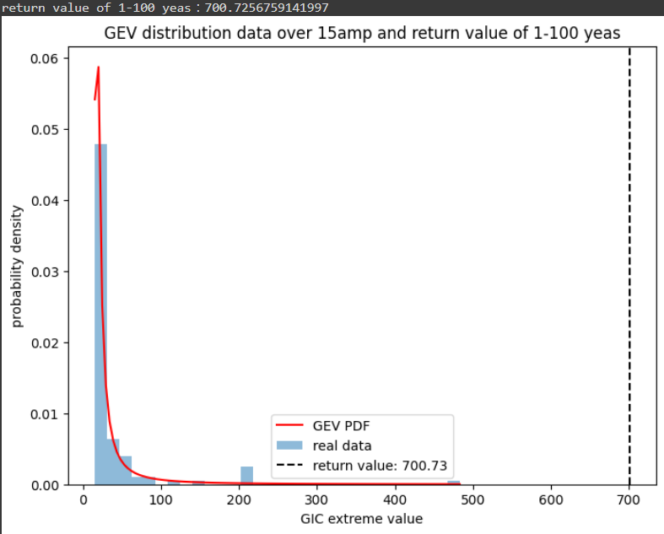
GIC extreme values ‘setting threshold’ into GEV model (Set a threshold of GIC value in general GIC EV dataset)
Return value of 1-100 years = 700.73 amp
We set a threshold value 15amp to our general GIC EV to filter out those low current values.
Issues:
The threshold value would strongly affect the 1-100 yrs return value.
Ex. thres = 20 => 1280amp

Slide 45
The return level is sensitive to ‘threshold value’
Threshold value <c | Return 1-100 ys value (amp) | Num of data
10 | 282.45 | 268
11 | 299.01 | 224
12 | 400.92 | 197
13 | 461.74 | 170
14 | 520.63 | 144
15 | 700.72 | 130
16 | 873.84 | 114
17 | 967.1 | 100
18 | 1102.81 | 89
19 | 1565.76 | 83
20 | 1336.3 | 73
Return value of 1-100 years = 700.73 amp
We set a threshold value 15amp to our general GIC EV to filter out those low current values.
Issues:
I think we need a scientific method to determine the threshold value.
I’ll look into the MRL plot mentioned in the EVA slides, but is there any other way you suggest ?

Slide 46
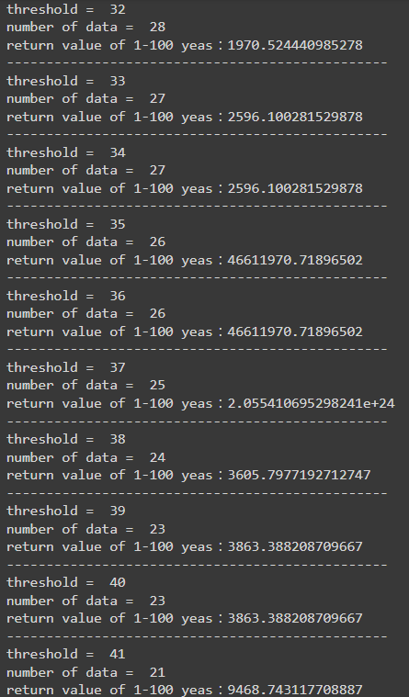
Threshold value <c | Return 1-100 ys value (amp) | Num of data
21 | 1939.39 | 67
22 | 2558.82 | 61
23 | 1879.51 | 53
24 | 2583.62 | 49
25 | 2160.78 | 46
26 | 2558.41 | 43
27 | 5951.1 | 41
28 | 5352.2 | 40
29 | 5471.92 | 37
30 | 7343.04 | 34
31 | 3727.05 | 32

Slide 47
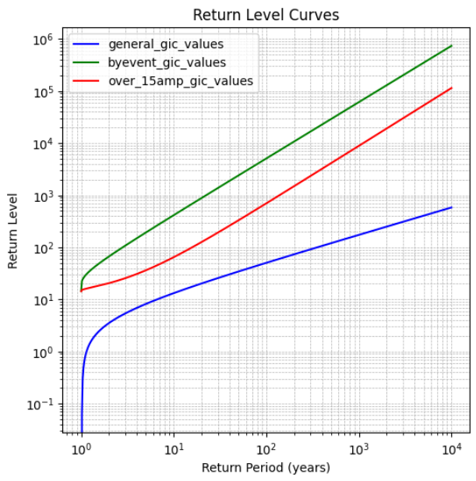
Return level plot for all 3 kinds of methods above
(amp)
5098.62
700.72
50.56

Slide 48
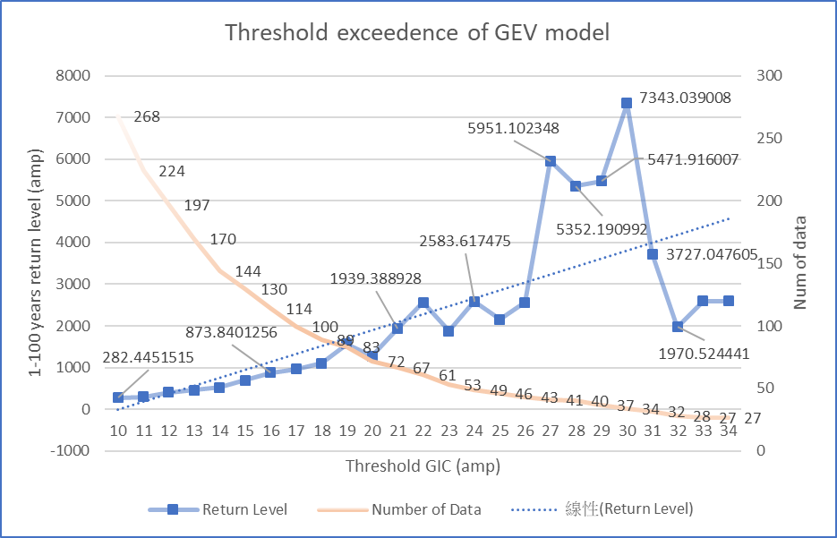
Part 1 : Visualizing GIC EV threshold for GEV return value
Issues 1 : The trend line is going up, but some data point are not (31, 32, 33, 34)

Slide 49
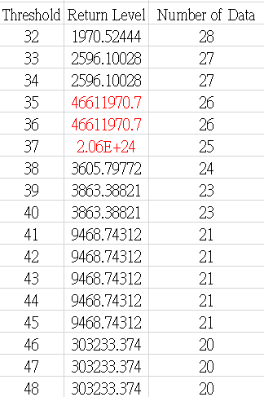
Issues 2 : Some data points are not reasonable (extremely high)

Slide 50
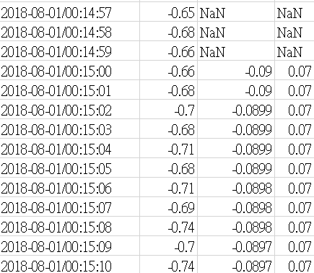
Part 2: New assigned data processing
Issues:
What are GIC_QDC & IQR ?
How should I process the raw data ?
Ideas of processing:
The dataset is 7 stations with same timeline (13 days). Extracting the EV with same time and combine into 1 dataset?
Then extract from every 1 hours?
Extract EV from each day? ( 13 days per node)

Slide 51


Visualizing GIC EV threshold for GEV 1-10 years return value
Issues: data over thres = 35 becomes unreasonable

Slide 52

Reasons that might cause the extreme surge
Reasons that might causes this happen:
Small numbers of samples lead to unstable and unrealistic estimates.(Wrong!)
Parameter instability: the shape, scale and location parameters of the GEV distribution can significantly changes in the threshold
The abnormal surge occurs exactly the same threshold as estimating 1-100 years Zt ( When it reach threshold = 35)
GIC EV that are over 30 amp

Slide 53

Bootstrap method
Randomly sample 80% of GIC EV
Threshold = 15 amp
For 1-100 years return value
The distribution of return level still vary, I think one significant cause is that whether the global maximum values is included or not. There are only 6 data that are over 200 amp

Slide 54

New QDC GIC data Node 1

Slide 55

QDC Node 1+2

Slide 56

QDC Node 1 ~ 7

Slide 57
Questions and Next step
Bootstrap method
I will try increase more sample times to see the distribution and record the boundary values
Try different return period times for further observation
See the 25% 50% 75% of the return level
Abnormal surge of return level in GEV model
I will do visualization and try different methods to find out the reasons that cause that.
Print out the scale, shape and location parameters of the GEV model
How should I fit the QDC dataset into GEV model or well-utilize this dataset?
The return period should also be set as 1-100 or 1-10 years? But there is only 1 year of data.
Return each node separately and also generate a general

Slide 58


Part 1: Visualization of GEV c, loc, scale parameters for 1-10 years return estimation
From observation, thres between 34~38 have abnormal c, loc, scale parameters values

Slide 59

Removing the abnormal section of threshold
To see the GEV parameters trend
The trend becomes more linear increasing after removing the section. But there is a small bump after thres = 45, and that causes an small surge of return level Zt.

Slide 60


Visualizing GIC EV threshold for GEV 1-10 years return value
(Removing section the from 34~38)

Slide 61


Part2: Bootstrap method for GIC return level
Return Period = 100 years, Thres = 15 amp, Sample time = 1000
The general return level (Without Bootstrapping) = 700.72 amp
By this Bootstrapping the result: Sum(Trial[i])/len(Trial) = 714.053 amp

Slide 62

Bootstrap method for GIC return level
Return Period = 10 years, Thres = 15 amp, Sample time = 1000 x Trial
Issues:
I am not quite sure about the purpose of 1-10 years return level. If we want to get a return value that reach the maximum of real data(which is 483 amp). We would have to set a threshold at least 42 amp, and that will result in only 21 data being taken into the GEV model.

Slide 63

Threshold = 42 amp
Return period = 10 years
Sample time = 1000 x 5 Trial
The average medium from 5 Trials = 393.2 amp
The maximum real GIC data = 483 amp

Slide 64
Part 3: GEV for QDC data
Followed by last week ‘s QDC dataset processing, after I set a threshold at 10 amp, most nodes have a problem of lacking number of data. As a result, I set a new threshold at 5 amp.

Slide 65


GEV return value from Node_2 to Node_7 Thres = 5 amp
Summary: Every node has big difference in return value, amount of low values is one of the main reasons

Slide 66
Interpreting the GEV parameter: shape
Shape: Determines the tail behavior of the distribution. A negative shape suggests that the distribution has a bounded upper limit, characteristic of the Weibull distribution.
Bounded Nature: The negative shape parameter and the resultant Weibull behavior imply that extreme GIC events have an upper limit in their magnitude. This could be due to physical constraints within the Earth’s geomagnetic environment and its interaction with solar winds.
Tail behavior: the bounded upper limit means that while extreme events are possible, there is natural cap to how intense these events can be, potentially linked to the saturation effects in the Earth’s magnetic field or the limiting magnitude of solar storm events.

Slide 67

Shape parameter of QDC

Slide 68


Slide 69

Latitude North < 40, Longitude West > -82(Feb 2023 event)
Max value occurred at monitor 10184(39.00 -78.20)
GICMeasured

Slide 70

Latitude North < 40, Longitude West > -82(March 2023 event)
Max value occurred at monitor 10427(39.00,-77.50)
GICMeasured

Slide 71

Latitude North < 40, Longitude West > -82(April 2023 event)
Max value occurred at monitor 10397(39.10, -78.30)
GICMeasured

Slide 72

Latitude North < 40, Longitude West > -82(April 2022 event)
Max value occurred at monitor 10184(39.00 -78.20)
GICMeasured

Slide 73

Latitude North < 40, Longitude West > -82(May 2021 event)
Max value occurred at monitor 10188(40.20 -74.50)
GICMeasured

Slide 74

Latitude North < 40, Longitude West > -82(Nov 2021 event)
Max value occurred at monitor 10195(39.70 -74.90)
GICMeasured

Slide 75

Latitude North < 40, Longitude West > -82(Aug 2018 event)
Max value occurred at monitor 10378(40.70 -74.00)
GICMeasured

Slide 76

Latitude North < 40, Longitude West > -82(Sep 2017 event)
Max value occurred at monitor 10405(39.50 -77.90)
GICMeasured

Slide 77

Feb 2023 event
Device1: 10051
Device2: 10184 (supernode,
39.00, -78.20)

Slide 78

March 2023 event
Device1: 10051
Device2: 10184 (supernode)

Slide 79

April 2023 event
Device1: 10052
Device2: 10184 (supernode)

Slide 80

April 2022 event
Device1: 10051
Device2: 10184 (supernode)

Slide 81

Nov 2021 event
Device1: 10051
Device2: 10195 (supernode)

Slide 82




Device: 10184
(supernode,
39.00, -78.20)

Slide 83




Device: 10184
(supernode,
39.00, -78.20)

Slide 84




Device: 10184
(supernode,
39.00, -78.20)

Slide 85




Device: 10184
max values from
15 events

Slide 86




Event 20230423
Device: 10065
(supernode,
41.80, -87.80)

Slide 87




Event 20230423
Device: 10066
(supernode,
41.60, -87.90)

Slide 88




Event 20230423
Device: 10069
(supernode,
41.90, -87.70)

Slide 89




Event 20230423
Device: 10094
(41.90, -72.5)

Slide 90




Event 20230423
Device: 10111
(43.40 , -123.00)

Slide 91




Event 20230423
Device: 10113
(45.60, -121.10)

Slide 92


GIC device 10427 (39°00'00.0"N 77°50'00.0"W, around DC)
20170527 2017 0907

Slide 93


GIC device 10427
20170927 20180825

Slide 94


GIC device 10427
20230226 20230323

Slide 95

Types of Extreme Values:
Block maxima Peaks over threshold
Notes:
Extreme value theory (EVT) is concerned with the occurrence and sizes of
rare events, be they larger or smaller than usual.
The first method is partitioning it into blocks of equal duration and locating maximum values within each block), fit a generalized extreme value distribution (GEV) GEV
One argument against this approach is that
use of maxima alone is wasteful of data: most of the information in the
sample is ignored.
the second method relies on extracting peak values above a certain threshold from a
continuous record, then declustering the exceedance time series , then selecting only the highest values within each cluster).
Generalized Pareto distribution.
A third approach the so-called r-largest order statistics represents a compromise between the block maxima and peak over threshold approach.

Slide 96

Peak over Threshold Analysis on NERC GIC Data (March 2023 event)
Notes:
employed the Pyextremes package, we conducted an analysis of peak over threshold values for all (GIC) monitors during the event that occurred in March 2023."
The density of extreme GIC values is concentrated around the East Coast, particularly near Washington, D.C., and in the Michigan area.
Moving forward, our focus will be on further analyzing peak over threshold values of monitors in the high-risk region ,fit the generalized Pareto distribution, get the return level . Then we will have a better understanding of the m-year return level, which represents the high quantile for which the probability that the annual maximum exceeds this quantile is 1/�
Provide insight into the likelihood and severity of extreme events within a given timeframe
Mean Residual Life

Slide 97

Network Analysis
Objective:
To quantify the magnitude and impact of Geomagnetically Induced Currents (GIC) on U.S power grid.
Approach:
Use wavelet decomposition on magnetic field & GIC data to determine significant changes and correlations.
Create a nodal network based on correlations.

Slide 98

Wavelet Decomposition
Step 1: Data Preprocessing is aligned with the time scale
Loaded the raw GIC data (NERC) and resampled data to align time scales.
Step 2: Perform the wavelet transform (Discrete/Stationary Wavelet Transform)
Extract coefficients for each GIC monitor (per event) visualized via heat map.
Step 3: Find correlation between wavelet coefficients of each station.
Utilized sliding window method for finding correlation.

Slide 99

Event: 2013 October 02 by Latitude

Slide 100

GIC Cross-Correlation Results by Device ID (threshold = 0.5)

Slide 101

Event: 2013 October 02

Slide 102

Major US Transmission Lines
k
Source: Climate Mapping for Resilience & Adaptation - Esri U.S Federal Datasets

Slide 103

Auroral Ejection Index Event: 20131002
AU = High Latitude
—-------------------
AL = Near equator
Asymmetry Index
ASY-D = East/West
ASY-H = North/South
NOTE: ASY-D & ASY-H represents the asymmetric disturbance component of the auroral electrojet currents. ASY-D changes in the east-west component of the auroral electrojet current system and ASY-H represents primarily related to changes in the north-south component.
SYM-H is the measure of geomagnetic activity that represents the symmetrical disturbance of the Earth’s magnetic field.
Source: WDC for Geomagnetism, Kyoto AE Index

Slide 104

Comparison
Event: 20131002
Auroral Ejection
Index
Wavelet Decomposition

Slide 105


Sliding-Window Method for Correlation
Station 1
—----------
Station 2

Slide 106

Heatmap of Cross-correlation

Slide 107

Cross-Correlation Overlay (Event: 2013 Oct 02)

Slide 108

Cross-Correlation Overlay (Event: 2013 Oct 02)

Slide 109

Cross-Correlation Overlay (Event: 2013 Oct 02)

Slide 110

continued…

Slide 111

continued…

Slide 112

Processing Limits.

Slide 113


Slide 114


Slide 115


Slide 116


Slide 117


Slide 118


Slide 119

Closeness - Centrality Measurement

Slide 120

Betweenness - Centrality Measurement

Slide 121

Eigenvector - Centrality Measure

Slide 122


Slide 123


Slide 124


Slide 125


Slide 126


Slide 127


Find threshold
Cij is the correlation between site i and site j at time t, and Ct is the global threshold
Average degree ni(CT) at different global threshold CT values.
Find a specific threshold CTi for each monitor so that the calculated average degree of each site is equal to the normalization degree n0.

Slide 128




Slide 129







200 points
10 points
Threshold Station 68 Station 54 Station 70 Station 82 Station 63

Slide 130

Device Specific Threshold (Varied) // Window = 15

Slide 131

Static Correlation Threshold = 0.95 // Window = 15

Slide 132
Machine Learning
Objective:
To predict and forecast GICs to mitigate the impact on the critical infrastructure through developing nowcast and predictive models for SuperMAG (dB/dt) and NERC GIC variables by exploring the most meaningful ML algorithms.
Approach:
Consolidate raw datasets: SuperMAG, OMNI and NERC GIC data.
Create analysis-ready datasets for magnetic perturbation prediction & NERC GIC values.
Preprocess dataset and feature engineering for training and testing purposes.
Experimenting with the following ML models:
Multivariate Linear Regression
LSTM(with Attention)/GRU

Slide 133
Data Flow for Magnetic Perturbation Prediction
API
Google Drive
Google Drive
Folder: data/SuperMAG/clean/
Folder: data/ML/
- Resampled to 5-min cadence.
- Missing values filled with mean interpolation.
- Separated into years file
SuperMAG
(2010-2023)
.csv
- Has total of 17 fields:
- 9 fields from SuperMAG data
- 8 fields from OMNI data
- Each .csv file contains data for one year
- Each file is about 3.5-4.0GB
Preprocessing Data Process
Dataset Creation Process
.csv
Folder: data/OMNI/clean/
OMNI
(2010-2023)
- Resampled to 5-min cadence.
- Missing values filled with mean interpolation, backward and forward values.
.csv
+ datetime
+ glon
+ glat
+ mlon
+ mlat
+ mlt
+ dbn_nez
+ dbe_nez
SuperMAG
OMNI
Filling missing and replace default values
Retrieve Data
Filling Missing Values
Resample to 5-min cadance
+ datetime
+ BX, BY, BZ (GSM)
+ flow_speed
+ proton_density
+ T
+ Pressure
+ Clock angle IMF

Slide 134

Multivariate Linear Regression
Dataset:
Features: glon, glat, mlon, mlat, mlt, BX_GSE, BY_GSM, BZ_GSM, flow_speed, proton_density, T, Pressure, SYM_H, CLOCK_ANGLE_GSM, ut_sin, ut_cos, day_sin, day_cos
Target: dbn_nez, dbe_nez
Current Experiment Result:
MSE (Mean Square Error) | dbn_nez: 68.19684114, dbe_nez: 42.6784768
MAE (Mean Absolute Error) | dbn_nez: 5.76408362, dbe_nez: 4.44876215
y-intercept | [4.50313219, -1.8351527]
slope

Slide 135


Result Graph (1 station)

Slide 136

Long-Short Term Memory (LSTM) Model
Dataset:
Region:
Not enough memory to run all available stations, and running on the whole dataset is time consuming, so I selected all available stations inside US.
Time:
Data of 2010 to 2022 for training, 2023 for validation.
Current Result:
Configuration:
360 batches, 0.001 learning rate, (ADAM) optimizer, MSE loss, 100 epochs
If not successful, will keep adjusting it until a better result.

Slide 137
Data Flow for GICs Prediction
API
Google Drive
Folder: data/ML/
Folder: data/NERC/FinalGIC.csv
- Will only use SuperMag data in this dataset
NERC GIC
(2013-2023)
Preprocessing Data Process
.csv
.csv
- Resampled to 5-min cadence.
+ datetime
+ GICMeasured
+ Longitute
+ Latitude
NERC GIC
Super-Mag
We joining the 2 dataframe by similar time
+ datetime
+ dbn_nez
+ dbe_nez
Notes:
s

Slide 138

Code Snipped Dataset and Model Training

Slide 139
Multivariate Linear Regression for GICs
Dataset:
Features: dbn_nez, dbe_nez
Target: GICMeasured
Current Experiment Result:
Mean Square Error(MSE) | 0.8741296430994946
Mean Absolute Error(MAE) | 0.44428231704672133
Root Mean Squared Error(RMSE) | 0.9349490056144745
R-squared(R2) | -0.0007798594554315752

Slide 140
Next Steps… (Spring 2024)
Extreme Value Analysis
Provide analysis as parameter input into machine learning models in regards to the time-frames most likely solar occurrences.
Network Analysis
Create a nodal network based on correlations between GIC sensors and visualize the physical GIC distribution given an overlay of the U.S power grid.
Machine Learning
Continue to train current machine learning models and explore different features to tune and accurately forecast upcoming solar events and its consequential impact on critical U.S infrastructure.

Slide 141
ML Team - Last Week
Working on reviewing the model
Tried working on temporal-convolutional network
Look through the possible dataset for Earth Conductivity data and power grid infrastructure data:
https://data.nasa.gov/dataset/Soil-Thermal-Conductivity-Data-FIFE-/7xzv-22eg/about_data
https://data.nasa.gov/dataset/Soil-Hydraulic-Conductivity-Data-FIFE-/4mtj-4xax/about_data
For power grid, we will corporate with Sean to learn more about that data.
Re-reading the feature engineering from this paper: https://agupubs.onlinelibrary.wiley.com/doi/10.1029/2022SW003045

Slide 142
Baseline Model for Magnetic Perturbation Predict
Created a doc to record baseline model performance:
https://docs.google.com/document/d/1VVmNB5LsLsf1u5qt6WPwspo1vVfizipKmeD8_qa7yXw/edit?usp=sharing
I have also created corner plots for all input features and kernel density plots for the targets (dbe and dbn separately) (graph on next slides)

Slide 143
Corner plots for all input features
https://app.slack.com/client/T06CA5VK37X/dms
Plot created using corner library:
Code to generate the plot:
https://drive.google.com/file/d/18QpAvBXr11QNdLvcE7L2n1puiCCdW2Wn/view?usp=drive_link
Plot created using seaborn library:
Code to generate the plot: https://drive.google.com/file/d/1i2a-0amE3K7XUh3R32qbUSmvzzP4nync/view?usp=sharing

Slide 144

Kernel density plots for the targets

Slide 145

GIC values prediction models
Datasets ready: dataset - Google Drive

Slide 146
GIC Models
Linear models

Slide 147




LSTM
(glon:76.920, glat:43.250)
2020- 2023 | dbn | dbe
RMSE | 1.620 | 1.288
MAE | 0.935 | 0.757
2023.4.23-2023.4.24 | dbn | dbe
RMSE | 7.013 | 6.900
MAE | 4.071 | 3.345

Slide 148


LSTM Test Result(Single Station)

Slide 149
Data Flow for GICs Prediction
Google Drive
data/ML/
API
Folder: data/NERC/FinalGIC.csv
- Will only use SuperMag data in this dataset
NERC GIC
(2013-2023)
Preprocessing Data Process
.csv
.csv
- Resampled to 5-min cadence.
+ datetime
+ glon
+ glat
+ mlon
+ mlat
+ mlt
+ dbn_nez
+ dbe_nez
+ datetime
+ GICMeasured
+ Longitute
+ Latitude
NERC GIC
Super-Mag
i
Google Drive
data/ML/NERC_GIC/Dataset
.csv
Containing Datasets ready from 2013-2023
We joining the 2 dataframe by datetime and Locations
.csv
.csv
Notes:
s

Slide 150

Devices and Stations Mapping
Station(Center): (38.5, 263.7)
Devices(around):
{(34.1, 206.8), (32.6, 262.8), (31.4, 264.6), (34.9, 270), (35.3, 270.2), (36.2, 271.2), …}

Slide 151

Train and Test Datasets split
Training Datasets
Test Datasets

Slide 152
Multivariate Linear Regression for GIC
Dataset:
Features: datetime , mlon, mlat, mlt, dbn_nez, dbe_nez
Target: GICMeasured
Current Experiment Result:
Mean Square Error(MSE) | 4.08974801
Mean Absolute Error(MAE) | 2.08750422

Slide 153


Result Graph

Slide 154


Kernel Density Plot

Slide 155
Random Forest Model for GIC
Hyperparameter: n_estimators=100, max_depth=30, random_state=2
Mean Square Error(MSE) | 5.82316737
Mean Absolute Error(MAE) | 2.31942044

